Slide 2
Leveraging Continuous Delivery for Magento 2
James Cowie
TTL @ Session Digital
Magento Master

Slide 3
Continuous Integration

Slide 4
Benefits
Say goodbye to long and tense integrations
Increase visibility which enables greater communication
Catch issues fast and nip them in the bud
Proceed in the confidence you’re building on a solid foundation
Reduce integration problems allowing you to deliver software more rapidly

Slide 5
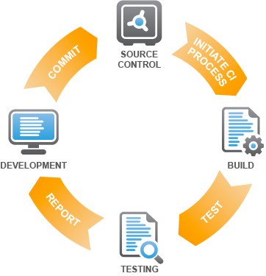

Slide 6
Continuous Delivery / Deployment
2 things of the same name

Slide 7
short cycles == Sprints
reliably released == Working software over comprehensive documentation
faster .. frequently == Responding to change over following a plan

Slide 8
Benefits
Accelerated Time to Market
Building the Right Product
Improved Productivity and Efficiency
Reliable Releases
Improved Product Quality
Improved Customer Satisfaction

Slide 9
Continuous Delivery
Acceptance
Tests
Deploy to
production
Code done
Unit Tests
Integrate
Manual
Continuous Deployment
Acceptance
Tests
Deploy to
production
Code done
Unit Tests
Integrate
Auto

Slide 10
How have I been working on Magento 1 & Magento 2

Slide 11
Pipeline Servers

Slide 12

QA

Slide 13
QA
UAT

Slide 14
QA
UAT
Live

Slide 15

QA
UAT
Live

Slide 16
RELEASE
QA
UAT
Live

Slide 17
RELEASE
RELEASE
QA
UAT
Live

Slide 18

RELEASE
RELEASE
QA
UAT
Live

Slide 19
RELEASE
RELEASE
QA
UAT
Live

Slide 20
What is time ?

Slide 21
https://en.wikipedia.org/wiki/Scrum_(software_development)

Slide 22
RELEASE
RELEASE
QA
UAT
Live
2 Weeks
?

Slide 23
How does this look in source control

Slide 24
Release Candidate
Develop
Master
QA
UAT
Live

Slide 25
Release Candidate
Develop
Master
QA
UAT
Live

Slide 26

The client wants a feature removed

Slide 27
Release Candidate
Develop
Master

Slide 28


Slide 29
Increased Time to deploy

Slide 30
What did I want improved ?

Slide 31
Feedback
Feedback
Feedback

Slide 32
Feedback time
-
=
Time
started
Feedback
given
Feedback
time

Slide 33
Feedback Time (Why ?)
Cognitive load & Human retention
Project flow
Validation

Slide 34



Feedback from who ?
QA Team
Real User
Team Lead
Stakeholder

Slide 35
Why
Internal Feedback
External Feedback

Slide 36
Why
Code analysis
Acceptance Criteria
Internal Feedback
Exploratory Testing
Regression Testing

Slide 37
Why
How does it look?
Are people using this feature?
How are people using this feature?
External Feedback
Is this feature solving a problem?

Slide 38
QA
UAT
2 weeks

Slide 39
UAT
LIVE
2 weeks

Slide 40
What options did I see?

Slide 41
Feature Branches

Slide 42
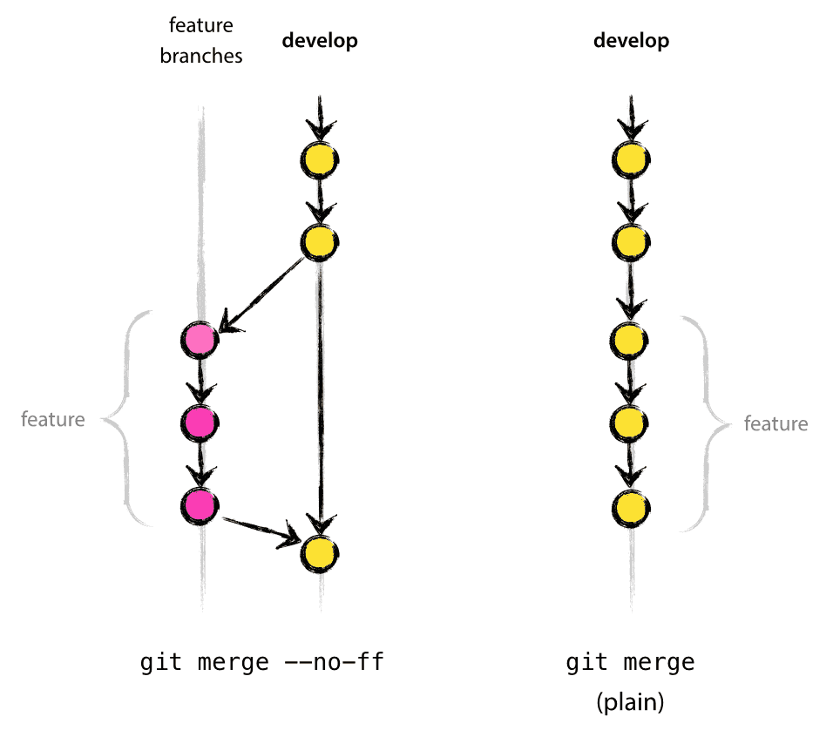

Slide 43
The rules of feature branching
Always deployable
Feature complete
Tests

Slide 44
feature.project.pipeline.com
Mainline
Live
Release
V1
feature2.project.pipeline.com
Uat.project.pipeline.com

Slide 45
Disadvantages
Advantages
Manual process
Feature branch rot
No reverse merging
Clear to see features

Slide 46


Slide 47
What are feature toggles ?
Disable / Enable
Logical switch

Slide 48
Feature toggle disabled
Mainline
Live
Feature toggle disabled

Slide 49
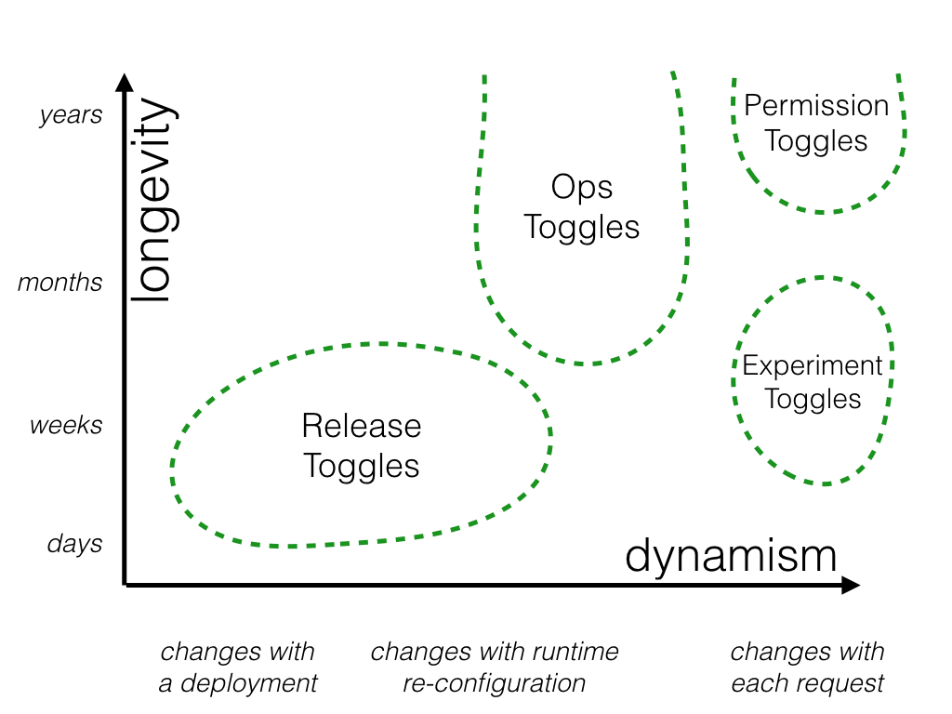

Slide 50
<?php … if ($someFeature)->isEnabled() {
…..
}
…

Slide 51
Disadvantages
Technical Debt
Extra code and configuration
JS / CSS ?

Slide 52
Benefits
Deploy all the things
A-B Testing
Easy revert
Client engagement in deploy

Slide 53
Our solution

Slide 54
Our solution
BDD
User Stories
Business Value
Example Workshops
Feature Toggles
Feature Branches
TDD

Slide 55
BDD ( Behaviour Driven Development )
Starts the conversation
Value
Intent
The Why!

Slide 56
User Stories
Becomes Acceptance Criteria
Thought about scenarios
Validation of the work

Slide 57
Business Value
What value does this story have.
What does it impact
How measurable is the story

Slide 58
Example Workshop
Final chance to “pull a story”
Understanding
Readiness for development

Slide 59
Feature Toggles
Admin config

Slide 60
Feature Branches
feature/PROJ-Number
Delete once passed review
Short lived

Slide 61
TDD ( Test Driven Development )
No feature without
Behat
PHPSpec
* Some PHPUnit for M2 *

Slide 62
How did we do it?

Slide 63
Github + Git

Slide 64
Magento 2
Sysconfig for toggle
Helper module for validation

Slide 65
Scrutinizer
Static Analysis
Running of tests
Deployment mechanism

Slide 66
Further reading

Slide 67

Further Reading

Slide 68
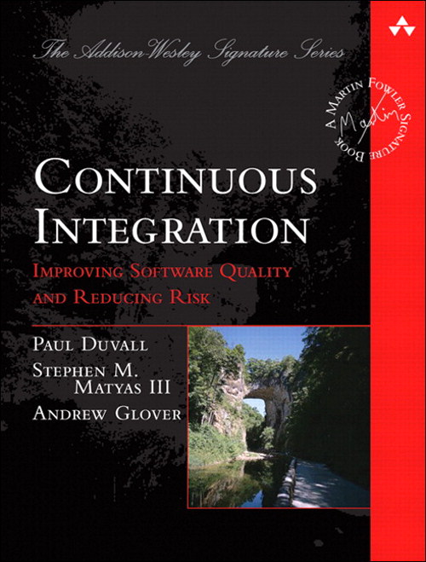
Further Reading

Slide 69
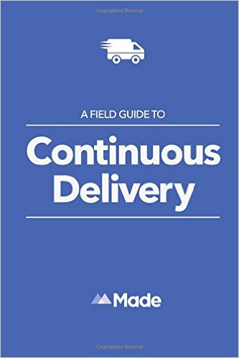
Further Reading

Slide 70

Further Reading

Slide 71
Q and A
@jcowie
Jamescowie (github)

